Slide 1


“In the name of Allah, The most Gracious,The most merciful ”
Introduction
Name: Fatima.
Father name: Abdul rehman.
From: Karachi , liyari town.
Age: 18 years old.
2nd year of college (pre-medical).
I am currently Cit student.

Slide 2


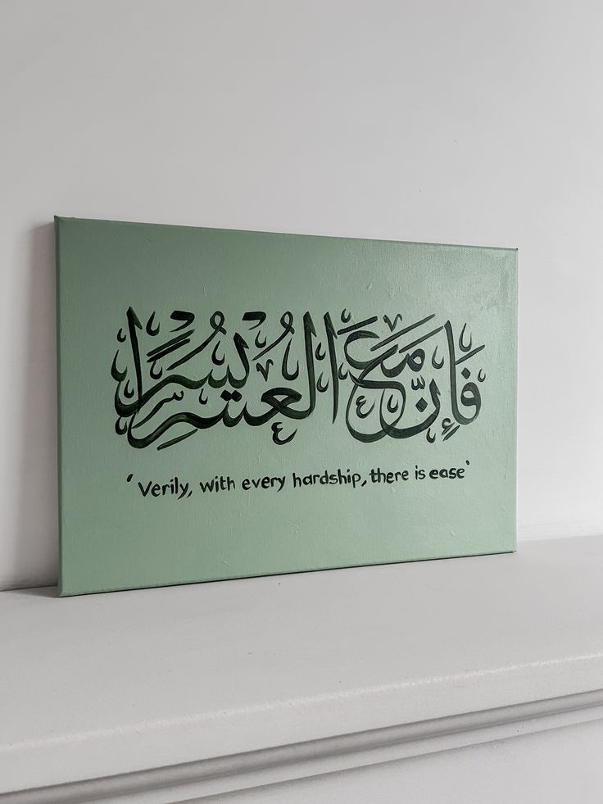
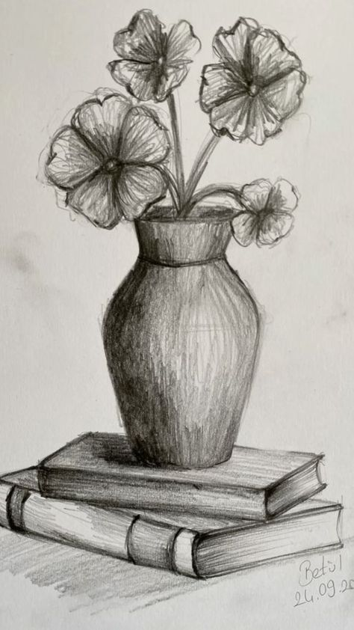
Personality traits:
Hard working
Patient
Creative
Social anxiety
Nervousness
Hobbies:
Calligrapghy
Drawing sketches
reading
Interest
food

Slide 3




Achievements:
Computer confidence .
First place in Calligraphy .
Skills learned in this course:
MS office , Excel.
Presentations in ppt.

Slide 4


Favorite topic / tool :
Presentations
MS power point

Slide 5




Strenghts and Weakness:
Introvert.
Anxious.
Easily distracted by phone/social media .
Communication skills.
Forgetful.
Honest.
Positive attitude.

Slide 6



Future Goals :
To become cardiologist.
Learning new things as much I want to.
Role Model / Inspiration:
My sister.
Parents.

Slide 7



Closing /Fun fact:
I knew 3 languages & learned 4th one and love to spend time with my best friend.
Most of things in my slides are lies but I wont tell you which one .
*Thank you for listening.*

